Slide 1



TOPIC OPTIMIZING THE MAXIMUM NUMBER OF NON-OVERLAPPING SUBSTRINGS
SAVEETHA SCHOOL OF ENGINEERING
SAVEETHA INSTITUTE OF MEDICAL AND TECHNICAL SCIENCES
CSA0697 DESIGN AND ANALYSIS OF ALGORITHM FOR LOWER BOUND THEORY
FACULTY NAME: Dr.Gnana Soundari
By
NAME : LAVANYA.R
REG.NO : 192210663

Slide 2
Given a string s of lowercase letters, you need to find the maximum number of nonempty substrings of s that meet the following conditions: The substrings do not overlap, that is for any two substrings s[i..j] and s[x..y], either j < x or i > y is true. A substring that contains a certain character c must also contain all occurrences of c. Find the maximum number of substrings that meet the above conditions. If there are multiple solutions with the same number of substrings, return the one with minimum total length. It can be shown that there exists a unique solution of minimum total length. Notice that you can return the substrings in any order. Example 1: Input: s = "adefaddaccc" Output: ["e","f","ccc"] Explanation: The following are all the possible substrings that meet the conditions: ["adefaddaccc" "adefadda", "ef", "e", "f", "ccc",] If we choose the first string, we cannot choose anything else and we'd get only 1. If we choose "adefadda", we are left with "ccc" which is the only one that doesn't overlap, thus obtaining 2 substrings. Notice also, that it's not optimal to choose "ef" since it can be split into two. Therefore, the optimal way is to choose ["e","f","ccc"] which gives us 3 substrings. No other solution of the same number of substrings exist.
PROBLEM STATEMENT

Slide 3


INTRODUCTION TO SUBSTRINGS
The Maximum Number of Non-Overlapping Substrings problem is about finding the most number of smaller parts (substrings) from a larger string. These smaller parts should not overlap or share any characters. The challenge is to pick as many of these substrings as possible without any of them having common characters.
The goal is to break the string into as many separate pieces as possible, where each piece is distinct and doesn't interfere with the others.

Slide 4


UNDERSTANDING SUBSTRINGS
A substring is a contiguous sequence of characters within a string. The goal is to identify the maximum number of non-overlapping substrings that can be derived from a given string, which is a common problem in computer science.

Slide 5

PROBLEM DEFINITION
The goal of this optimization problem is to ﬁnd the maximum number of non-overlapping substrings from a given string.
This involves determining the length and character composition of each substring while ensuring that no characters are shared between them.

Slide 6

EXAMPLE
Input string: "abbaccd"
Steps:
Find possible substrings:
"a" (from index 0 to 0)
"bb" (from index 1 to 2)
"cc" (from index 4 to 5)
"d" (from index 6 to 6)
Non-overlapping substrings:
"a" (from index 0 to 0)
"bb" (from index 1 to 2)
"cc" (from index 4 to 5)
"d" (from index 6 to 6)
None of these substrings overlap, so you can select all of them.
Output:
["a", "bb", "cc", "d"]
This gives the maximum number of non-overlapping substrings as 4.

Slide 7

KEY STRATEGIES FOR OPTIMIZATION
Several strategies can be employed to optimize the extraction of non-overlapping substrings, including greedy algorithms, dynamic programming, and backtracking techniques.
Each approach has its advantages and is suited for diﬀerent types of input data and constraints.

Slide 8


GREEDY ALGORITHM TECHNIQUE
The greedy algorithm is another approach where we make the locally optimal choice at each step. This method can be useful for certain types of substring problems, especially when the goal is to maximize the number of selections.

Slide 9

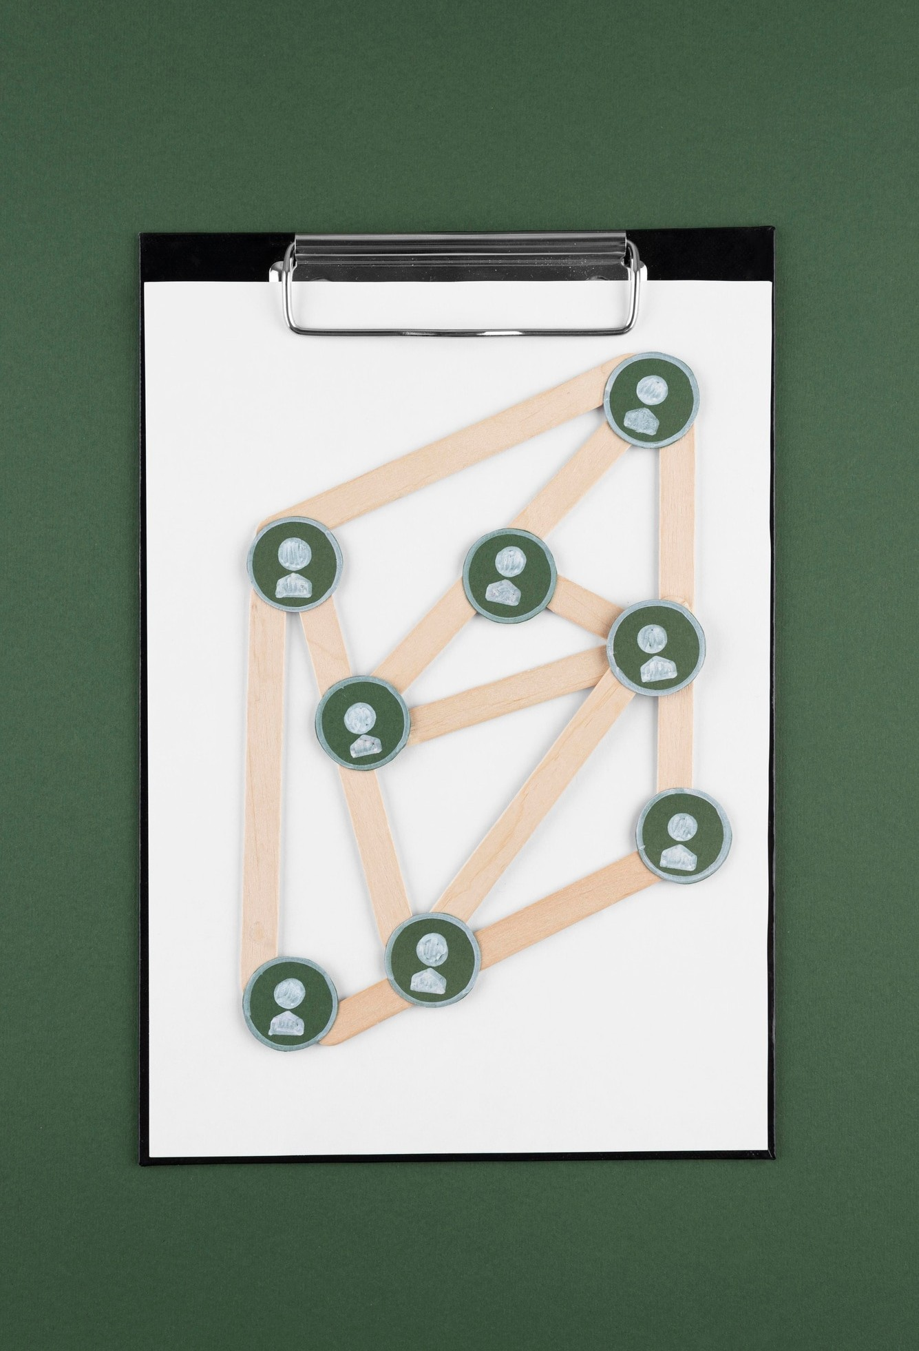
Backtracking Methodology
Using backtracking allows for exploring all possible combinations of substrings. This method can be particularly useful when searching for speciﬁc patterns or constraints within the substrings, albeit at a higher computational cost.

Slide 10

DYNAMIC PROGRAMMING TECHNIQUES
Dynamic programming is a powerful technique that solves problems by breaking them down into overlapping subproblems. By storing results of previously computed substrings, it can eﬃciently compute the maximum count of non-overlapping substrings in a given string.

Slide 11

USING HASHING TECHNIQUES
Implementing hashing can improve the efficiency of substring searches. By storing substrings in a hash table, we can quickly check for duplicates and manage overlaps, signiﬁcantly speeding up the process.

Slide 12
PSEUDOCODE FOR MAXIMUM NUMBER OF NON-OVERLAPPING SUBSTRINGS
void findMaxNonOverlappingSubstrings(char[] s) {
int first[26], last[26];
int n = length(s);
// Initialize first and last occurrence arrays
for (i = 0; i < 26; i++) first[i] = last[i] = -1;
// Record first and last positions of each character
for (i = 0; i < n; i++) {
int index = s[i] - 'a';
if (first[index] == -1) first[index] = i;
last[index] = i;
}
int end = -1; // Tracks the end of the current non-overlapping substring
for (i = 0; i < n; i++) {
int index = s[i] - 'a';
if (first[index] == i) {
int new_end = last[index];
// Expand to cover all characters within the substring
for (j = i; j <= new_end; j++) {
new_end = max(new_end, last[s[j] - 'a']);
}
// If no overlap, add this substring
if (i > end) {
printSubstring(s, i, new_end);
end = new_end;
}
}
}
}
void printSubstring(char[] s, int start, int end) {
for (i = start; i <= end; i++) printf("%c", s[i]);
printf("\n");
}

Slide 13


COMPLEXITY ANALYSIS
Understanding the time and space complexity of different algorithms is crucial.
Each method has its strengths and weaknesses, and analyzing their performance helps in selecting the best approach for speciﬁc scenarios.

Slide 14

REAL-WORLD APPLICATIONS
Optimizing non-overlapping substrings has practical applications in ﬁelds like bioinformatics, text mining, and natural language processing. These applications beneﬁt from efficicient substring handling for better data analysis.

Slide 15

CHALLENGES IN OPTIMIZATION
Despite the strategies available, challenges such as large datasets, overlapping criteria, and variable substring lengths can complicate the optimization process. Identifying these challenges is vital for developing robust solutions.

Slide 16

FUTURE DIRECTIONS
Future research may focus on enhancing existing algorithms and exploring new methodologies for substring optimization.
Innovations in machine learning and artiﬁcial intelligence may also provide fresh perspectives on tackling these problems.

Slide 17

CONCLUSION
In conclusion, optimizing the maximum number of non-overlapping substrings is a complex yet rewarding endeavor.
By employing various strategies and understanding their implications, we can signiﬁcantly enhance performance in relevant applications.

Slide 18
REFERENCES
G. Gallo, M.D. Grigoriadis, R.E. Tarjan. (1989). A Fast Parametric Maximum Flow Algorithm and Applications. SIAM Journal on Computing, 18(1), 30-55. DOI: 10.1137/0218002
Cormen, T. H., Leiserson, C. E., Rivest, R. L., & Stein, C. (2009). Introduction to Algorithms (3rd ed.). MIT Press.
Tarjan, R. E. (1972). Depth-First Search and Linear Graph Algorithms. SIAM Journal on Computing, 1(2), 146–160. DOI: 10.1137/0201010
Gusfield, D. (1997). Algorithms on Strings, Trees, and Sequences: Computer Science and Computational Biology. Cambridge University Press.
Knuth, D. E., Morris, J. H., & Pratt, V. R. (1977). Fast Pattern Matching in Strings. SIAM Journal on Computing, 6(2), 323–350. DOI: 10.1137/0206024

Slide 19
THANK YOU

